Slide 1
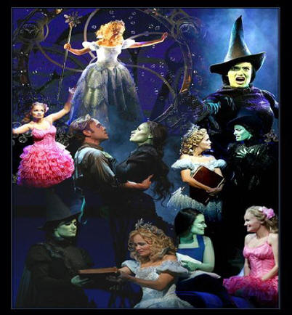
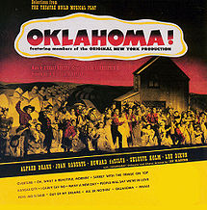
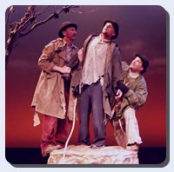
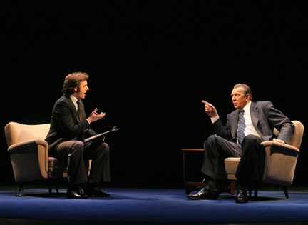
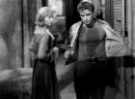
19th to 21st Century Theatre

Slide 2
19th Century Developments
Romanticism: focusing on the “ideal” rather than the real; idea that trust should be put in instincts rather than reason and nature rather society for guidance & answers
Playwright’s job becomes recording life rather than creating a whole new world in each play
Industrial revolution is in full swing and the railroads are booming… this development allows theatre companies to travel to smaller cities & towns that had never had theatre available to them on a regular basis

Slide 3
19th Century Melodrama
Uses a simple, suspenseful plot and exaggerated characters to appeal to the emotions
Standard characters: a hero (always the fearless one), heroine (the love of the hero, usually the one that the hero saves), villain (usually likes the heroine too) and villain's sidekick (typically gets in the way of the villain)… they are one-dimensional characters with very little character development
Plots, movements, speaking patterns are all very over-the-top and contrived
Uses music and spectacle (technical advances in theatre allow new effects) to draw new and expanding audiences
Sets-props-costumes all had to be show-specific and historically accurate, so design and building expanded

Slide 4
19th Century Melodrama
Standard Melodrama characters that still exist today…
The Hero & Heroine
The Villain and his sidekick

Slide 5
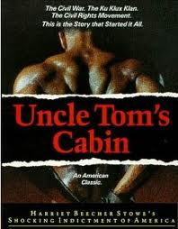
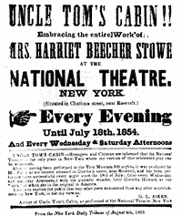
19th Century Melodrama
Introduces the “common hero” –
a regular person who does extra-
ordinary things (saves the day)
Values virtue & goodness above all
else and sees it as the solution to
mankind’s problems (good & evil are very clear cut)
Most widely produced play of the 19th century: Uncle Tom’s Cabin (based on the Harriet Beecher Stowe novel)

Slide 6
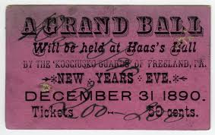
19th C Theatre Companies
Repertory company: one group of performers performs a repertoire (set) of shows for a season – most popular until…
The Star system develops: a theatre company is formed around 1 prominent actor, they travel & perform
Theatrical Syndicate forms in 1896 to book touring shows in their performance locations around the country (hello, Ticketmaster?)
– they hold a monopoly on
booking until 1915!!
Early 20th C… companies are pretty well gone – actors are hired for specific roles in specific plays.

Slide 7
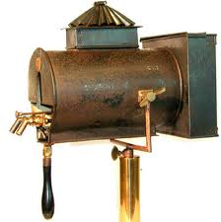
19th Century Realism
Begins in France c. 1850
Playwrights see their purpose to
be revealing social ills & injustices
Aided by tech advances that made for more believable settings: the box set (sets look like the places they are supposed to be!) and gas lighting (allows specific lighting & use of the upstage areas & inside set pieces)

Slide 8
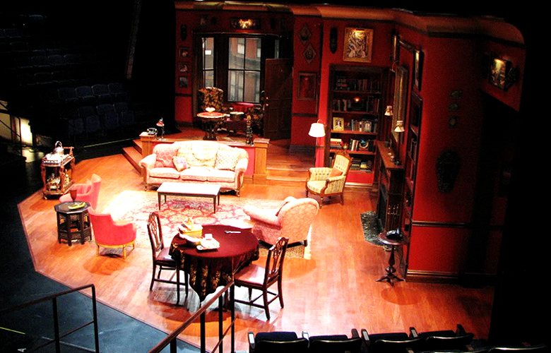
The BOX set (or unit set)…

Slide 9
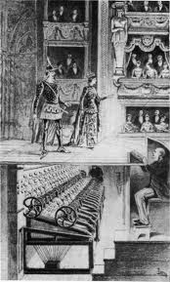
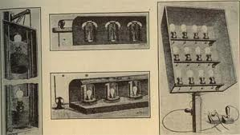
19th Century – Gas stage lighting

Slide 10
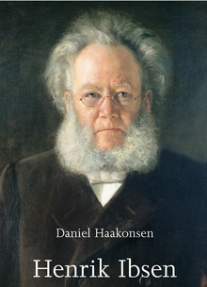
Henrik Ibsen Norway (1828 – 1906)
“The Father of modern drama” - leads the realism movement
Wrote about socially significant themes
Stops using soliloquies & asides (unnatural)
Writes round, well-developed, flawed characters
Significant plays: A Doll’s House & Hedda Gabler

Slide 11
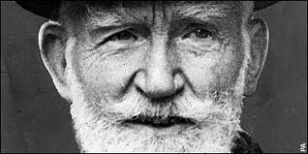
George Bernard Shaw England/Ireland (1856 – 1950)
Most important English playwright of his time
Witty plays/satires (comedy) emphasize social themes & feature believable, well-developed characters
Significant plays: Pygmalion (My Fair Lady) & The Arms and the Man

Slide 12
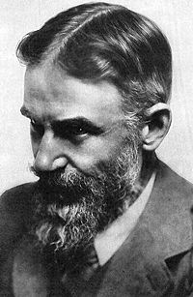
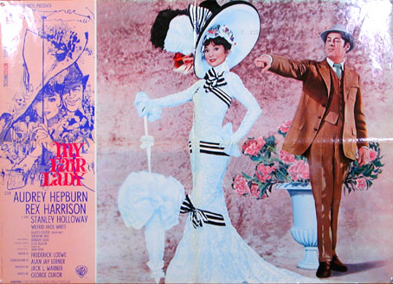
George Bernard Shaw - Ireland
1856 – 1950
Inspired by Ibsen; he’s the one who stages Ibsen for English-speaking audiences – wants to bring more realism to English theatres
Writes plays about real problems & social issues – war, class issues, prostitution, Church corruption
Important titles… “Arms and the Man,” “Pygmalion,” “Mrs. Warren’s Profession,” “Saint Joan”
Discovered the power of comedy to make a point

Slide 13
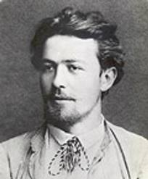
Anton Chekhov Russia (1860-1904)
Russian playwright who presents sympathetic characters (we easily connect with them) who are defeated by their circumstances
Significant plays: Uncle Vanya, Anna Karenina, The Seagull & The Cherry Orchard

Slide 14
19th Century – the Director
Because of tech advances, need for historical accuracy, and need for consistent plot/character interpretations… we get one person in charge of it all… the DIRECTOR!
Director’s “vision”: the overall idea/look/concept for the whole show that the Director is responsible for creating
George II, Duke of Saxe-Meiningen (Germany) = first stage director!! – he refines the idea of ensemble acting – where no one actor is more important than another & the total production is the most important of all

Slide 15
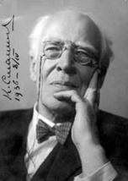
Konstantin Stanislavski Russia (1863 – 1938)
1897 – founds the Moscow Art Theatre (dedicated to the ensemble concept, naturalness, clarity & simplicity)
Develops a system of acting & character-building that focused on creating truthful emotions and embodying them onstage
Developed his principle of opposites

Slide 16
Stanislavski’s “system”
The 'system' focused on the development of artistic truth onstage by teaching actors to "experience the part" during performance
His systematic approach includes work on concentration, voice, physical skills, emotional memory, observation, imagination, and dramatic analysis
a.k.a. “American method” or “method acting”

Slide 17
Stanislavski’s Principal of Opposites
“When you play a good man, try to find out where he is bad, and when you play a villain, try to find where he is good”
Why? An actor MUST find something sympathetic to connect with in order to play the character well.

Slide 18
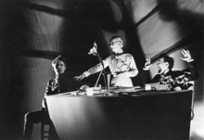
20th Century Theatre - Expressionism
Bring to life the struggle of the protagonist against middle-class values
Shows the emotional
awakening of characters
Usually stark productions;
dark, sad, emotionally jarring
Plays are highly symbolic in subject matter & content
Popular in the US in the early 20th C

Slide 19
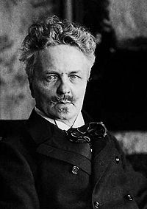
August Strinberg Sweden (1849 – 1912)
Wrote about spiritual pilgrimages
Tried to abolish conventional
dramatic time and space and the splitting, doubling, merging, and multiplication of its characters
Becomes important influence on many American playwrights
Significant plays: The Ghost Sonata and Miss Julie

Slide 20
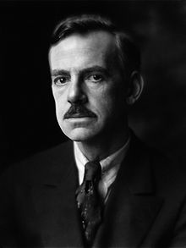
Eugene O’Neill USA (1888 – 1953)
Highly influenced by Strinberg
Won the Nobel prize for Literature once,
and the Pulitzer for Drama four times
Most of his plays involve some degree of tragedy and personal loss
His plays were among the first to include speeches in American vernacular and involve characters on the fringes of society, where they struggle to maintain their hopes and aspirations, but ultimately slide into disillusionment and despair
Significant plays: The Hairy Ape, The Iceman Cometh, A Long Day’s Journey into Night

Slide 21
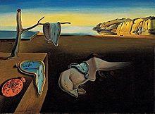
20th Century Surrealism
Develops in Paris during WW1, continues into WW2
Combines many other styles (theatre of cruelty, absurdism, etc.)
Main idea: the breaking down of barriers between the inner & outer, conscious & unconscious in actors and audience – we can never define the true self because we are many things at one time

Slide 22
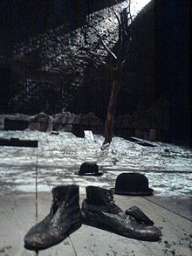
20th Century Theatre of the Absurd
Develops in France from the ideas of Existentialism and in reaction to the atrocities of WW2
Main ideas: truth is found in disorder and chaos – there is no higher purpose/point to life – nothing is inherently good or bad, it’s just how a human sees the subject that gives it value
Plays are characterized by physical comedy, nonsense dialogue, spastic movement, flat & inter-dependent pairs of characters,

Slide 23
Existentialism
Philosophical movement from the 1940’s based on ideas from Kierkegaard and Nietzsche that looks at why we exist and what the point of that existence might be
a whole theatrical movement is born: Theatre of the Absurd!!
Genre characteristics… minimalist sets & costumes, quick & simple dialogue, nonsense talk, repetition, physical humor, lots of metaphor & symbolism, confusion in characters & audience
Important playwrights… Samuel Beckett, Eugene Ionesco, Harold Pinter, Tom Stoppard…

Slide 24
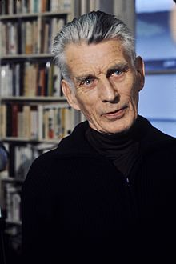
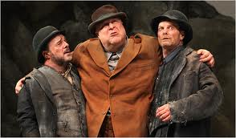
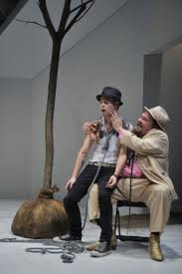
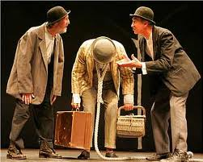
Samuel Beckett Ireland (1906 – 1989)
Absurdist playwright
Won the Nobel Prize for Literature
Wrote Waiting for Godot – considered the archetypal absurdist play

Slide 25
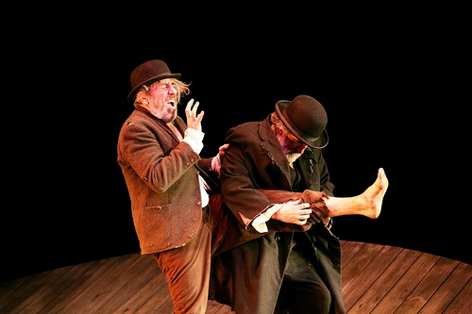
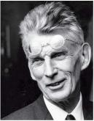
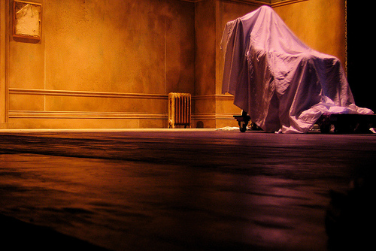
Samuel Beckett
Moves to Paris & becomes part of the French Resistance during WWII, sees the carnage 1st hand & is very affected by it
Main subject… despair and the will to survive in spite of that despair, in the face of an uncomprehending and, indeed, incomprehensible world
Important works… “Waiting for Godot” (1949), “Krapp’s Last Tape” (1958), “Happy Days” (1960)

Slide 26
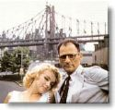
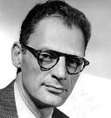
Arthur Miller America (1915 – 2005)
Changes realism by centering his plots on ordinary characters – most significant = Willy Loman, the “anti-hero” from Death of a Salesman, 1949 – wins Pulitzer Prize (a poor, unsuccessful salesman is dying physically & emotionally)
Makes it “cool” to be socially aware because of the success of his plays and by marrying Marilyn Monroe
The Crucible, 1953, allegory that tells the story of witch-hunts and the persecution of innocent people in the 1600’s – while providing commentary on the McCarthyism of the 40’s & 50’s

Slide 27
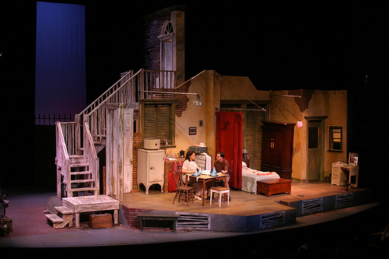
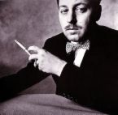
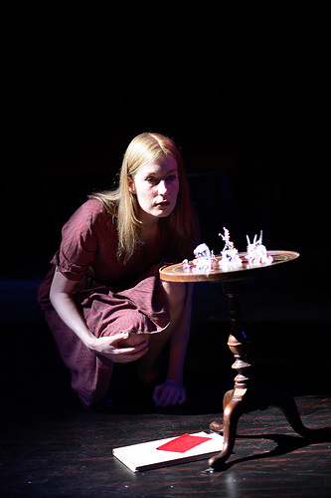
Tennessee Williams American (1911 – 1983)
Writes realistic tragedies – the most popular of the 20th C
Characteristics of his writing include painfully real characters, rich dialogue, poetic language, very American & southern settings, focuses on family relationships
Play subjects: alcoholism, insanity, adultery, poverty, homosexuality, family conflict
Important titles… The Glass Menagerie (1945), Street Car Named Desire (1947), Cat on a Hot Tin Roof (1954)
He’s such a good writer, & his plays are so popular, that he’s accepted as an openly-gay celebrity by America

Slide 28
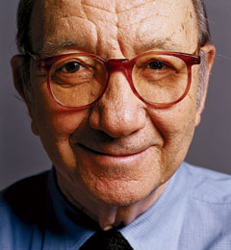
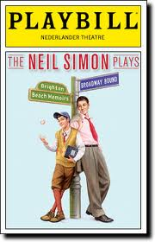
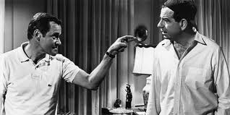
Neil Simon American (1927 – present)
Most commercially successful comedic playwright in the world!!
Won Pulitzer Prize for Drama (1991)
Writes about serious concerns for regular people such as marital conflict, infidelity, sibling rivalry, adolescence, and fear of aging
Most plays are at least partially autobiographical
Significant plays: Brighton Beach Memoirs,
The Odd Couple, and Lost In Younkers

Slide 29
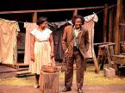
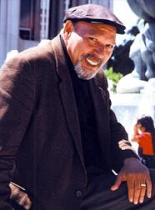
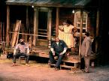
August Wilson American (1945 – 2005)
African-American playwright that focuses on the experiences of black people in America
Wrote The Pittsburgh Cycle, a series of 10 plays that cover each decade of the 20th C
Fences (1985) & The Piano Lesson (1990) won Pulitzer Prizes

Slide 30
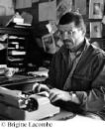
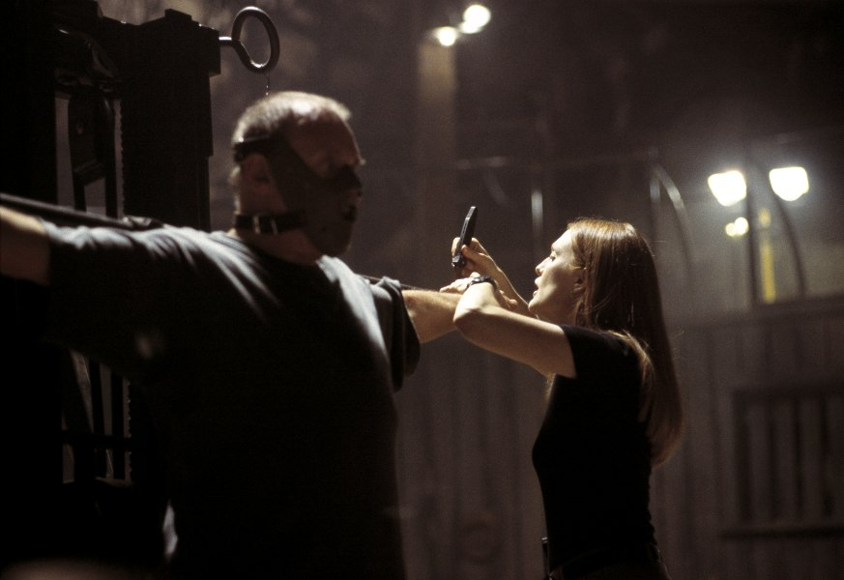
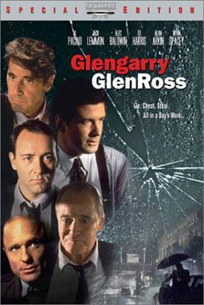
David Mamet American (1947 – present)
Author, playwright, screenwriter, director
Known for clever, often vulgar dialogue & his examination of masculinity
Important titles… “Sexual Perversity in Chicago” & “American Buffalo” (1976), “Glengarry Glenross” (1984) won Pulitzer Prize
Films… “The Postman Always Rings Twice,” “The Untouchables,” “Wag the Dog,” “Hannibal”

Slide 31
The American Musical 20th Century
The first & only truly American contribution to theatre
Becomes very important as a way of discussing topics that would otherwise be taboo – “if you put it to song & dance, it’s ok”
Develops from
the “operetta” (romantic story with song & dance)
Vaudeville (a collection of acts – song,dance, magician, comedian, trained animals, etc.)
Burlesque (musical/theatrical parody, then striptease-ish )
Combines a “book” (script), lyrics, and dance –
all 3 equally important
all contribute to plot & character

Slide 32
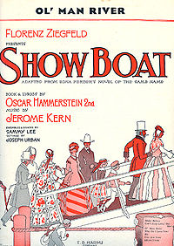
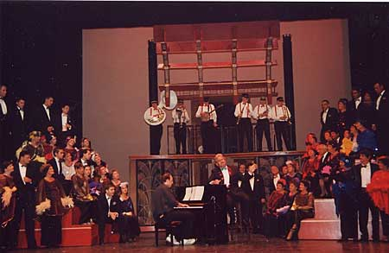
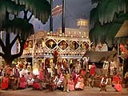
Showboat
1927 – Jerome Kearns & Oscar Hammerstein II
Story of the love between a black woman & a white man

Slide 33
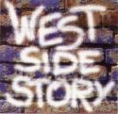
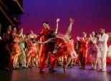
West Side Story
1957, Bernstein, Laurents & Sondheim
Choreography by Jerome Robbins!
Modern version of Shakespeare’s Romeo & Juliet
Deals with gangs, race relations, rape

Slide 34
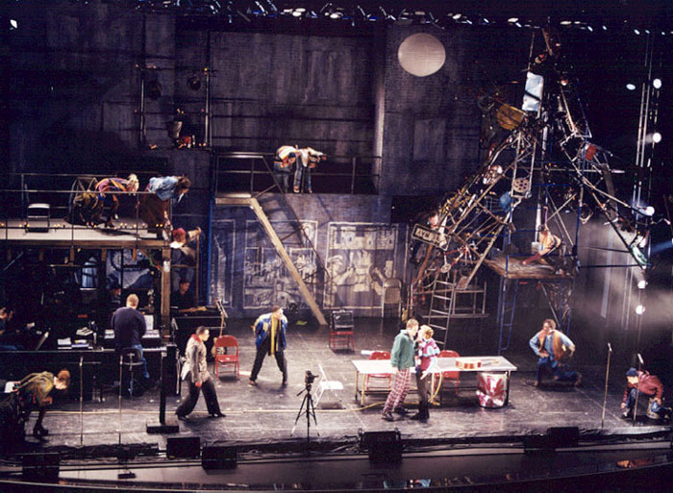
1996, Jonathan Larson
Adaptation of Puccini’s La Boheme
Deals with poverty, drug addiction, violence, AIDS, homosexuality,

Slide 35
2004, Robert Lopez & Jeff Marx
A combination of a tribute to PBS Sesame Street & a look at social issues – esp. homosexuality
Combines humans and puppets

Slide 36
1997, Elton John & Tim Rice, directed by Julie Taymor
Adaptation of the Disney film
Revolutionary use of puppets and masks with live actors to create a real jungle feel onstage
These puppets were an updated version of Bunraku

Slide 37
The Book of Mormon is a
satirical look at the Mormon
religion
Spring Awakening tells the story
coming of age of a young girl in a
very conservative, traditional world
In the Heights is a salsa-
dancing, melodrama about
Latinos in uptown Manhattan

Slide 38
20th & 21st C Theatre Spaces
Performance spaces become more varied
The Black Box theatre comes into regular use (an intimate, flexible performance space)

Slide 39
20th & 21st C Theatre Spaces
An arena stage (or Theatre in the round) provides a very intimate unique perspective with little division between audience and performer

Slide 40
20th & 21st C Theatre Spaces
Multi-purpose spaces are often created for amateur and community theatre performances

Slide 41
20th & 21st C Theatre Spaces
Found space is any performance space that brings audience and performers together

